Slide 1

VISION-BASED HUMAN ACTIVITY RECOGNITION USING DEEP LEARNING
CS5720 Neural Network & Deep Learning - Project

Slide 2
Group members info:
NAME | ID NUMBER
Anusha Sree Belli | 700758644
Yasaswini Majety | 700747747
Bhavana Billa | 700756590
Ruchitha Surakanti | 700753219

Slide 3
Roles and Contribution:
Anusha Sree Belli:
Collected or obtained a video collection comprising labeled human activity data.
The video data was preprocessed, including scaling, normalization, and augmentation.
Managed data pipelines and storage to allow quick access during training. Developing robust training data sets.
Yasaswini Majety :
Fine-tunes pre-trained models created from scratch using the dataset.
Optimized hyperparameters and loss functions to boost model performance.
Depends on outcomes after evaluating model performance with validation and test sets.

Slide 4
Roles and Contribution:
Bhavana Billa:
Created software modules that process video input streams.
Integrated the deep learning model into the software's design.
Implemented real-time inference capabilities for detecting human activity.
Ruchita Surakanti:
Created test cases and strategies to validate the functionality of the software and model.
Performed manual and automated testing to detect flaws and issues.
Verified that the program fits the specifications and functions as expected.
Provided comments to the development team regarding issue repairs and improvements.

Slide 5

Abstract:
This study introduces an innovative method for vision-based human activity recognition (HAR) by leveraging Convolutional Neural Networks (CNN) and transfer learning.
HAR has gained importance in diverse fields such as elderly monitoring, anomaly identification, and security systems. Conventional machine learning methods have been surpassed by deep learning models, which can autonomously extract features while minimizing computational resources.
In our research, we employ a CNN model to identify human activities from image data sets. By applying transfer learning, we effectively obtain deep image features and train machine learning classifiers. Our experiments utilize the VGG-16 framework, achieving an impressive accuracy rate of 96.95%. Additionally, our findings highlight the enhanced performance of VGG-16 when compared to alternative CNN models used for HAR. This investigation contributes to the development of HAR techniques and presents a promising approach for vision-based activity recognition across various practical application.

Slide 6
Objectives:
Developing a Robust Model
Exploring Transfer Learning
Dataset Collection and Preparation
Model Evaluation Metrics
Hyperparameter Tuning
Cross-Validation and Testing
Comparative Analysis
Real-Time Inference
Documentation and Reporting
Future Directions

Slide 7
Motivation:
Improving Quality of Life
Empowering Assistive Technologies
Advancing Computer Vision
Real-World Applications
Innovation and Research
Addressing Societal Needs
Learning and Growth
Potential for Impact
Project has the potential to make a meaningful difference in people's lives while also contributing to the advancement of science and technology. Stay motivated, stay curious, and enjoy the journey of discovery and innovation!

Slide 8
Related work:
"Two-stream convolutional networks for action recognition in videos" by Karen Simonyan and Andrew Zisserman.
"Learning spatiotemporal features with 3D convolutional networks" by Du Tran et al.
"Self-supervised learning for human activity recognition: A comprehensive survey" by Manish Kumar and Balasubramanian Raman.
Studying these works had provided valuable insights and inspiration for our research and experimentation.

Slide 9
Problem statement:
Human activity recognition (HAR) plays a crucial role in various applications, including healthcare monitoring, surveillance, and human-computer interaction. Traditional methods for HAR often rely on handcrafted features and shallow learning algorithms, which may struggle to capture the complex spatiotemporal patterns present in video data.
To address this challenge, this project aims to develop an efficient and accurate vision-based human activity recognition system using transfer learning and convolutional neural networks (CNNs).

Slide 10
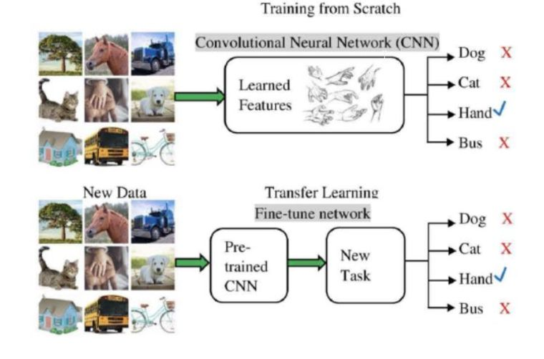
Problem solution:

Slide 11

Results :

Slide 12

Results :

Slide 13
References :
[1] Samundra Deep,Xi Zheng Department of Computing Macquarie University “\textbf{Sydney, Australia Conference" }Leveraging CNN and Transfer Learning for \textbf{Vision-based Human Activity Recognition}". International Acess number:19572619.DOI:10.1109/ITNAC46935 2019.9078016.
TelecommunicationNetworks and Applications Date Added to IEEE Xplore:27 April 2020 INSPEC R. Alazrai, M. Hababeh, B.A. Alsaify, M.Z. Ali, M.I.Daoud, An End-to-End. Deep Learning Framework for Recognizing Human-to-Human Interactions. Using Wi-Fi Signals, The developed end to end deep learning model provides 86.3 accuracy for all human-to-human interactions recognition. The proposed
model is not developed for group-to-group interactions. This model will work only for Human-to Human Interactions. IEEE Access. 8 (2020) 197695– 197710.

Slide 14
References:
[4] Y. Jia, Y. Guo, G. Wang, R. Song, G. Cui, X. Zhong, Multi-frequency and multi-domain human activity recognition based on SFCW radar using deep learning, Neurocomputing. Developed deep learning model ncreases the recognition accuracy by 1.3\% by additionally introducing the range maps. The proposed model is not developed for group- to- group interactions N. Zehra, S.H. Azeem, M. Farhan, Human activity recognition through ensemble learning of multiple convolutional neuralnetworks, It takes less amount of preprocessing time because the proposed model support automatic feature extractions. Model is not suitable for concurrent activity recognition 2021 55th Annu. Conf. Inf. Sci. Syst. CISS 2021. (2021).

